Slide 1
Johnson and Johnson. Investor presentation
Course
Name
Date

Slide 2
Table of content
Introduction
Key performance indicators
•Stock and the P/E Ratio
•Market Cap
•Trends
••The pharmaceutical segment
Recomandation
Conclusion
References

Slide 3
Key indicators
Revenue growth.
Net profit margin
Operational cash flow
Current account receivable
Notes:
Johnson and Johnson company ticker and primary motivation was to improve lives. The company’s initial products were sterilized surgical products. It’s the leading pharmaceutical, which generates 47 percent of revenues and 58 percent of operating profits; medical devices and diagnostics, which accounts for 36 percent of revenues and 31 percent of operating profits; and consumer, which contributes 17 percent of revenues and 11 percent of operating profits, For the stock dividend and the yields, When Joseph Lister's discovered that airborne germs were a source of infection in the operation room, she teamed up with his brothers James Wood Johnson and Edward Mead Johnson. The three brothers decide to make employee dressings for protection in an old wallpaper factory.
Revenue growth.- From its initial revenue, the Johnson Company has developed ways to ensure that they increase their income. They made brunches in their company, which is the pharmaceuticals, medical devices, and diagnostics. There are functions that are all functional and important for company growth. Market share cap. This is the calculable profit between a given financial period. It is often calculated in percentages. The net profit margin of the Johnson Johnson Company between 2006 and 2020 has grown drastically as it has improved by 19.78%. The analytic comment with regards to this stock. This is the liquid cash available in an organization at the moment. Johnson has a sizeable current cash flow, as it has too many activities going on at the same time. It is necessary to consider that the company is always running at a profit. The revenue and the estimates for that were current accounts receivable. This is the amount owed by debtors. With the Johnson Company, they do not have large accounts received as they do not sell their goods on the verdict. Inventory turnover.

Slide 4
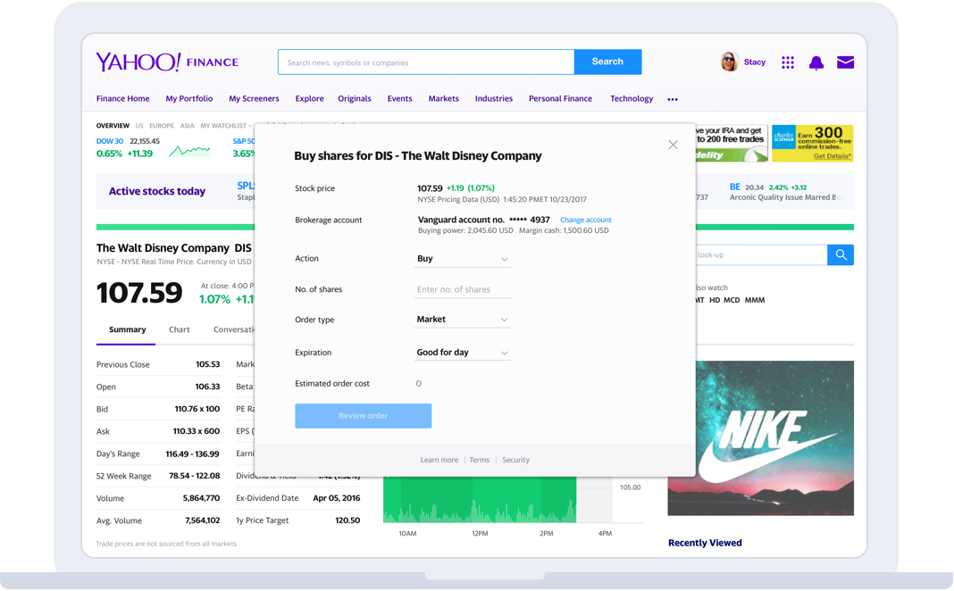
Stock to PE ration
From its initial revenue, the Johnson Company has developed ways to ensure that they increase their income.
They made brunches in their company, which is the pharmaceuticals, medical devices, and diagnostics.
There are functions that are all functional and important for company growth.
Notes:
https://finance.yahoo.com/quote/JNJ?p=JNJ&.tsrc=fi...&guccounter=1

Slide 5
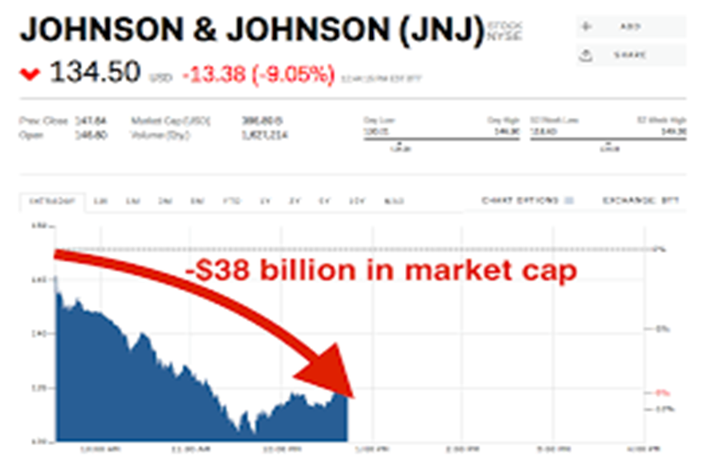
Market cap
Notes:
Johnson & Johnson Market Cap 2006-2020 | JNJ
Prices
Financials
Revenue & Profit
Assets & Liabilities
Margins
Price Ratios
Other Ratios
Other Metrics
Stock Price History
Stock Splits
Market Cap
Johnson & Johnson market cap history and chart from 2006 to 2020. Market capitalization (or market value) is the most commonly used method of measuring the size of a publicly traded company and is calculated by multiplying the current stock price by the number of shares outstanding. Johnson & Johnson market cap as of October 23, 2020 is $382.39B.

Slide 6
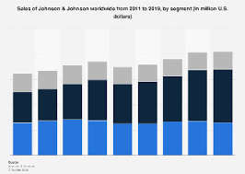
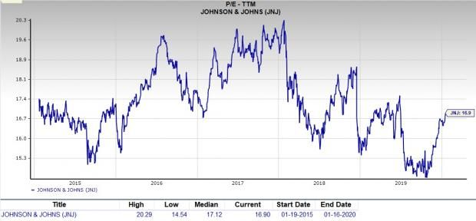
Trends
Notes:
S&P 500
3,385.44-79.95(-2.31%)
Dow 30
27,540.85-794.72(-2.80%)
Nasdaq
11,303.17-245.11(-2.12%)
Russell 2000
1,602.78-37.72(-2.30%)
Crude Oil
38.55-1.30(-3.26%)
Gold
1,904.70-0.50(-0.03%)
LIVEYahoo Finance All Markets Summit: Road to Recovery
An all-star lineup of business leaders tell us what to expect amid generational change.
Johnson & Johnson (JNJ)
NYSE - Nasdaq Real Time Price. Currency in USD
Add to watchlist
143.27-1.97 (-1.36%)As of 2:46PM EDT. Market open.
Summary
Company Outlook
Chart
Conversations
Statistics
Historical Data
Profile
Financials
Analysis
Options
Holders
Sustainability

Slide 7
Recommendation
The consumer product business offers many products ranging from baby care.
Beauty and over the counter products seem to be the fastest moving Johnson’s products.
The Johnson & Johnson have been trying to improve their profitability.
improvements in Johnson & Johnson is the change in marketing strategies.

Slide 8
Conclusion
Johnson and Johnson was founded in 1886.
The orthopedic segment makes the most sales for the medical devices segment.
Consumer revenue which contributes 17 percent of revenues and 11 percent of operating profits.
The consumer product business offers many products ranging from baby care.

Slide 9
References
https://finance.yahoo.com/quote/JNJ?p=JNJ&.tsrc=fi...&guccounter=1
Cavallo, K., & Brienza, D. (2002). Emotional competence and leadership excellence at Johnson & Johnson: The emotional intelligence and leadership study. Consortium for Research on Emotional Intelligence in Organizations, 1-12.
Henke, R. M., Goetzel, R. Z., McHugh, J., & Isaac, F. (2011). Recent experience in health promotion at Johnson & Johnson: lower health spending, strong return on investment. Health Affairs, 30(3), 490-499.

